Slide 1

Geometry
Unit 6, Lesson 5 Drawing Transformations Volume 1, pg. 307

Slide 2


Benchmark
MA.912.GR.2.5
Given a geometric figure and a sequence of transformations, draw the transformation on a coordinate plane.
volume 1, pg. 307

Slide 3
Integrated Mathematical Thinking and Reasoning Standards
MA.K12.MTR.2.1 Demonstrate understanding by representing problems in multiple ways.
MA.K12.MTR.5.1 Use patterns and structure to help understand and connect mathematical concepts.
MA.K12.MTR.6.1 Assess the reasonableness of solutions.
volume 1, pg. 307

Slide 4

Learning Target
I can draw the transformed figure when given a geometric figure and a sequence of transformations as a written description or an algebraic description.
volume 1, pg. 307

Slide 5

Warm-Up
volume 1, pg. 307

Slide 6
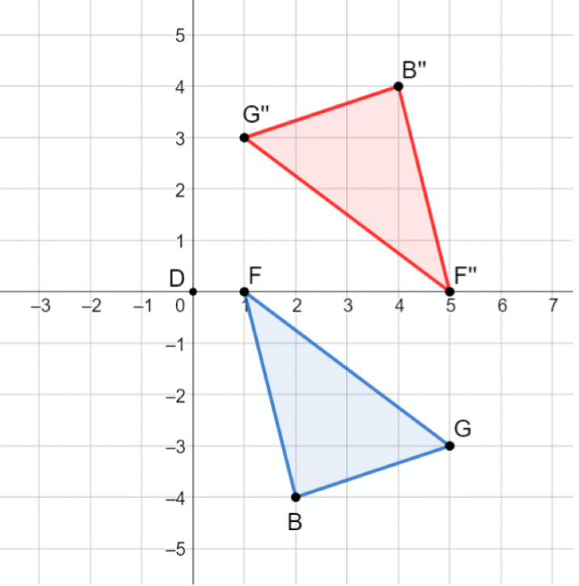
6.5.1 Warm-Up: Error Analysis
$∆BGF$ was transformed by a sequence of transformations to create $∆B′′G′′F′′$.
volume 1, pg. 307

Slide 7
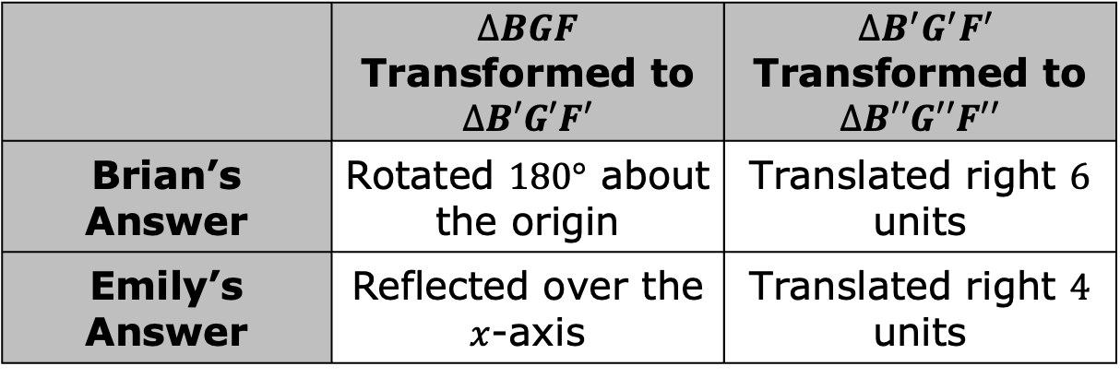
Brian and Emily were determining the sequence of transformations and wrote their answers in the table.
Determine whose sequence of transformations is correct. Explain your reasoning.
 | $∆BGF$ Transformed to $∆B′G′F′$ | $∆B^{′}G^{′}F^{′}$ Transformed to $∆B′′G′′F′′$
Brian’s Answer | Rotated $180°$ about the origin | Translated right $6$ units
Emily’s Answer | Reflected over the $x$-axis | Translated right $4$ units
volume 1, pg. 307

Slide 8

Guided Instruction
volume 1, pg. 308

Slide 9
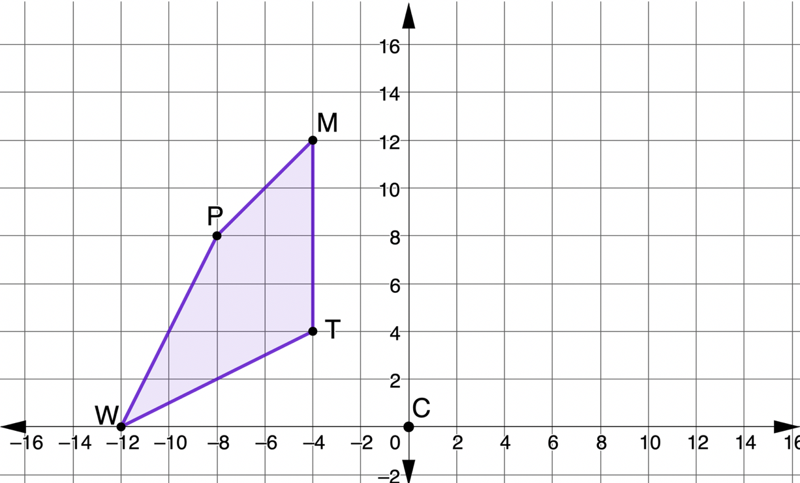
6.5.2 Guided Instruction: Drawing Transformations
$MTWP$ and point $C$ are shown on the coordinate plane.
volume 1, pg. 308

Slide 10
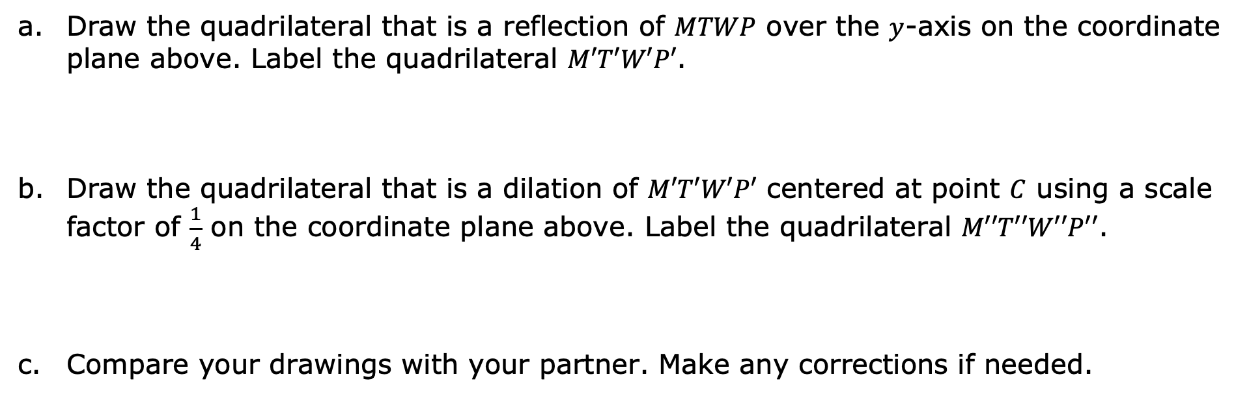
Draw the quadrilateral that is a reflection of $MTWP$ over the $y$-axis on the coordinate plane above. Label the quadrilateral $M′T′W′P′$.
Draw the quadrilateral that is a dilation of $M′T′W′P′$ centered at point $C$ using a scale factor of $\frac{1}{4}$ on the coordinate plane above. Label the quadrilateral $M′′T′′W′′P′′$.
Compare your drawings with your partner. Make any corrections if needed.
volume 1, pg. 308

Slide 11
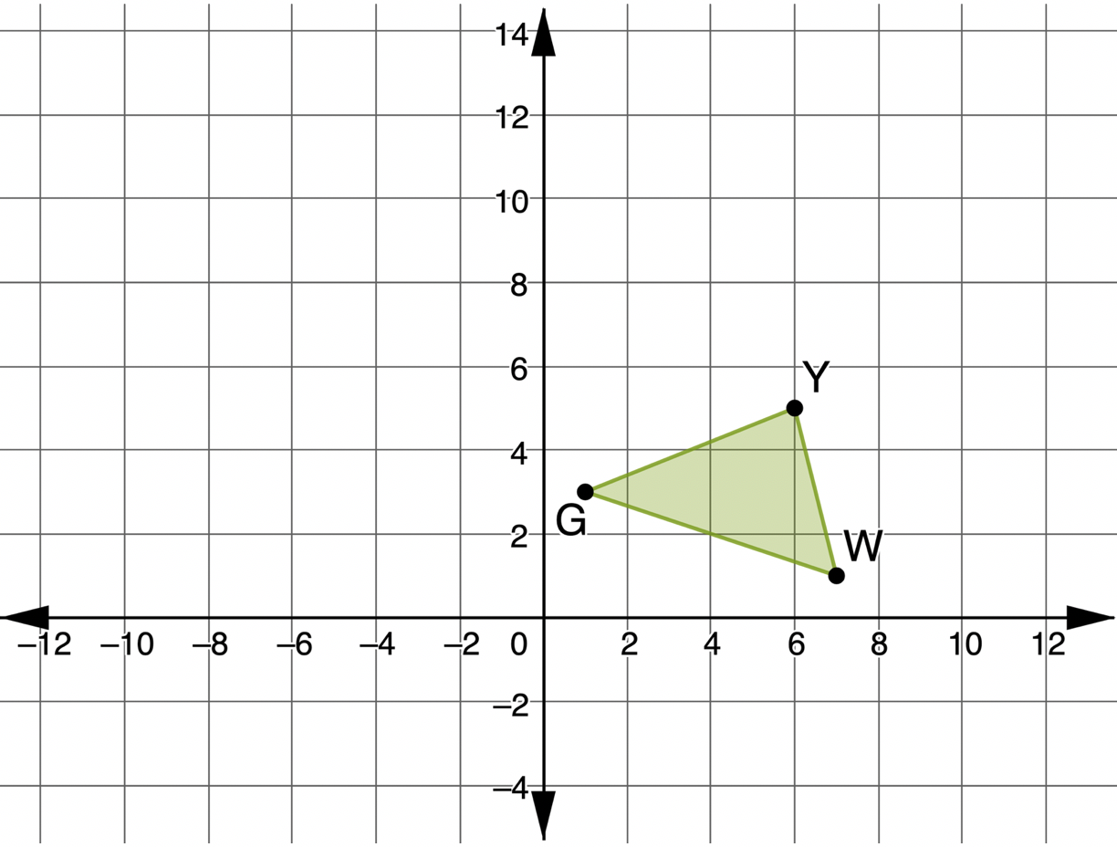
$∆GYW$ is shown on the coordinate plane.
volume 1, pg. 308

Slide 12
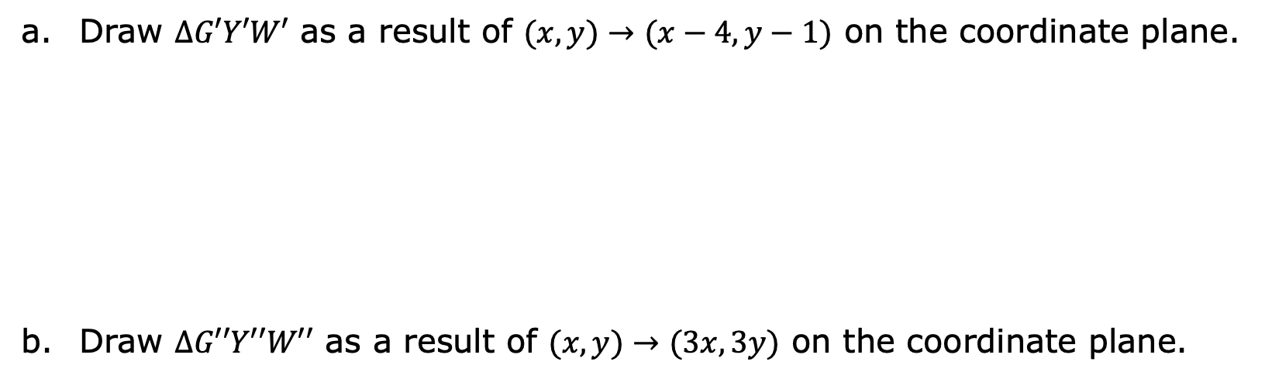
Draw $∆G′Y′W′$ as a result of $(x,y)→(x−4,y−1)$ on the coordinate plane.
Draw $∆G′′Y′′W′′$ as a result of $(x,y)→(3x,3y)$ on the coordinate plane.
volume 1, pg. 308

Slide 13
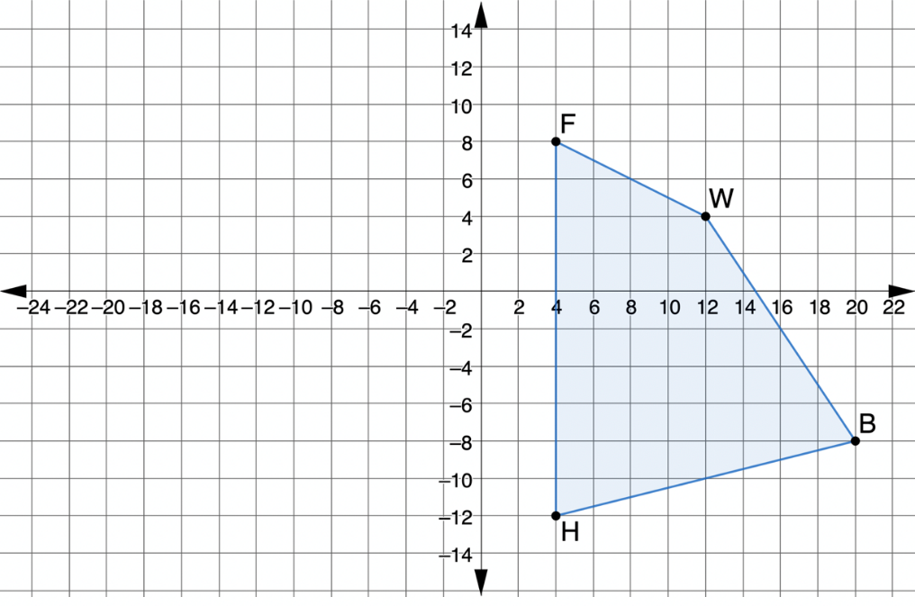

$FWBH$ is shown on the coordinate plane.
On the same coordinate plane, draw $F′′W′′B′′H′′$, which is a result of dilating $FWBH$ using a scale factor of $\frac{3}{4}$, with the center at point $F$, then rotating the quadrilateral $90°$ clockwise about point $F$.
volume 1, pg. 309

Slide 14

Guided Practice
volume 1, pg. 309

Slide 15

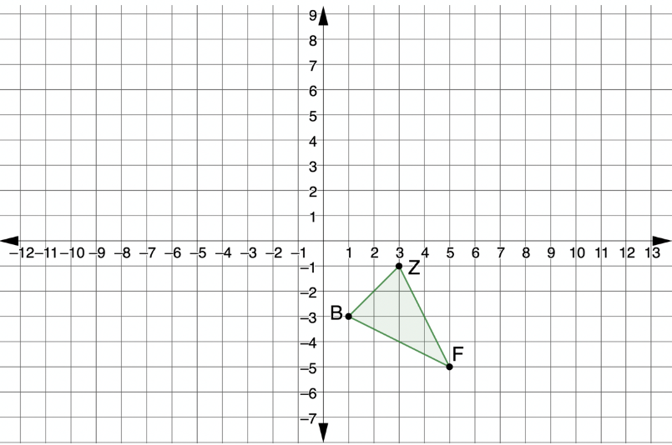

6.5.3 Guided Practice: Sequence of Transformations
$∆FZB$ is shown on the coordinate plane.
On the same coordinate plane, draw $∆F^{′′′}Z^{′′′}B^{′′′}$, which is the result of a reflection over the $x$-axis, then translated left $3$ units and down $3$ units, then dilated with a scale factor of $\frac{5}{2}$ using point $Z′′$ as the center of dilation.
volume 1, pg. 309

Slide 16

Your Turn
volume 1, pg. 310

Slide 17
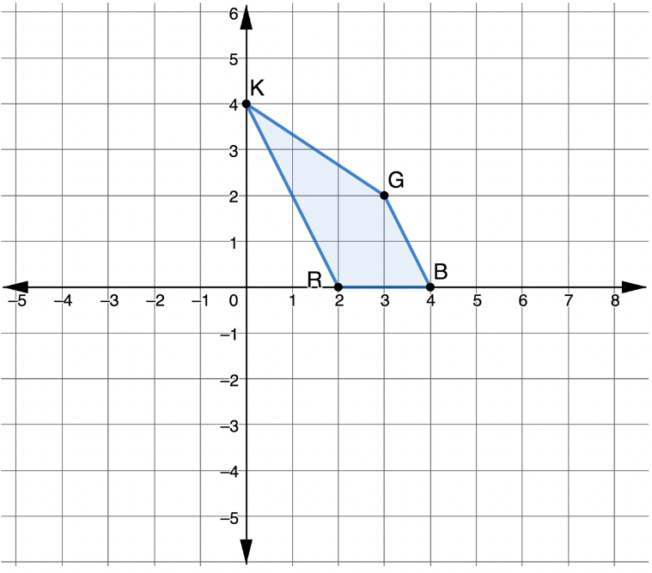

6.5.4 Your Turn!
$KGBR$ is shown on the coordinate plane.
On the same coordinate plane, draw $K′′G′′B′′R′′$, which is the result of $(x,y)→(y,−x)$, then $(x,y)→\left(\frac{1}{2}x,\frac{1}{2}y\right)$.
volume 1, pg. 310

Slide 18

Wrap-Up
volume 1, pg. 310

Slide 19
6.5.5 Wrap-Up: Cool Down
Why do you think it is important to use the prime notation when working with transformations?
volume 1, pg. 310

